Slide 1


Language Awareness for Key Stage 3

Slide 2
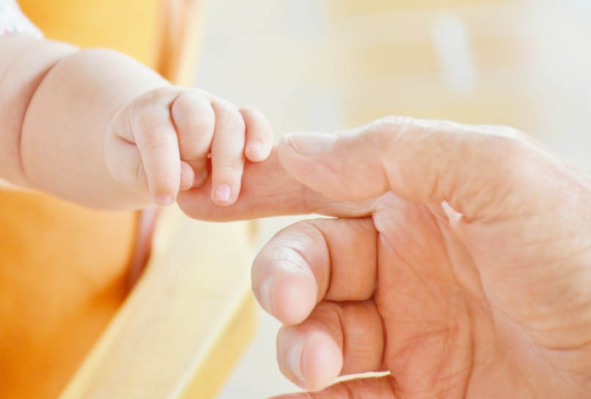
Language learning
Babies are able to learn a language by instinct
  They learn words and also rules for how to put the words together
However, these instincts fade as they get older
Learning a language later in life takes more than just being exposed to it
It also takes more than just memorising words and sentences

Slide 3
Studying languages
When you first encounter other languages, they often seem very different from English
In some languages different nouns need different forms of adjectives and other words
  We call these different ‘genders’, but this is not the same as the ‘natural’ gender you see in English
un bon homme a good man
une bonne femme a good woman
un bon vélo a good bike
une bonne voiture a good car

Slide 4
Studying languages
When you first encounter other languages, they often seem very different from English
In some languages, the order of words may not be what you expect
Ich dachte, dass er es gesehen hatte
I thought that he it seen had
‘I thought that he had seen it’
Ich hatte es gesehen
I had it seen
‘I had seen it’

Slide 5
Studying languages
Learners often find these differences off-putting and confusing
Understanding the reasons for these differences can help reduce confusion
This involves comparing languages consciously, rather than just trying to pick up patterns unconsciously

Slide 6
What is linguistics?
Studying patterns in language can help us to understand things that all languages have in common
It can show us that different languages can be more similar underneath than on the surface
​Analysing these patterns is what people do in linguistics, the scientific study of language

Slide 7
What do linguists study?
There are many aspects of language that linguists study

Slide 8
What do linguists study?
The form of language (e.g. sounds, spelling)
  The different languages of the world have many different vowels and consonants
  These range from very common (e.g. the vowel <oo>) to very rare (e.g. the clicks used in some African languages)
a ɐ ɑ ɒ b ɓ ʙ β c ç ɕ d ɗ ɖ ð e ə ɚ ɘ ɛ ɜ ɞ f ɡ ɠ g ɢ
ʛ ɣ ɤ h ħ ɦ ɧ ɥ ʜ I ɨ ɪ j ʝ ɟ ʄ k l ɫ ɬ ɭ ʟ ɮ m ɱ ɯ ɰ
n ɲ ŋ ɳ ɴ o ʘ ɵ ø œ ɶ ɔ p ƥ ɸ q r ɾ ɺ ɽ ɹ ɻ ʀ ʁ s ʂ ʃ
t ʈ θ u ʉ ʊ v ʋ ʌ w ʍ x χ y ʎ ʏ z ʑ ʐ ʒ ʓ ƻ ʔ ʡ ʖ ʕ ʢ

Slide 9
What do linguists study?
Clicks are found in languages like Sandawe, spoken in central Tanzania

Slide 10

What do linguists study?
Wekẽ nĩ x'agkasu udtaa aa kongomawãgki, gka' ho sambosẽ wa'mee-sambõts'i c'usugkusẽ. Ts'ekhenasãts'i bpaa miindzo-ncemeseeaa c'usugku, kotia hic'ã. Ke'egkwãgki'a gka', baaraã miindzo-ncemeseẽx'a' koti dtugkweets'esẽ, hewe sambosẽ.
Wekẽ bpaa baaraa wekẽ'õga, pagka hewe-sambo-tcheegki'õnaa. Bpaa hia urĩga wekẽgi', bpaa miindzo-ncemeseẽgkiaa, hewe-kotĩga dtelhaa nqa'agkaa. Pagka tcheegki'õna, wekẽ bpaa x'a'. X'agkasũsu saa dtelhasa hix'ĩ'ĩsa na'. Saã urĩ ba'etcheets'i, miindzo-ncemeseẽ, bpaa hewe-kotĩga dtugkwee. Nĩ hewemee, wekẽ bpaa meenaa gkiagka', x'agkasũsu sambosusu hewe õtce.
© International Phonetic Association (Eaton 2006)

Slide 11
What do linguists study?
The meanings expressed by language
  Literal meanings
    What is the difference between This may be true and This might be true?
  Non-literal meanings
    e.g. It’s getting a bit cold = Please shut the window
∃w(w∈W & P⋂w)
◇∃w(w∈W & P⋂w)
∃e(C(e)) ≈ !∃e(S(e,w))

Slide 12
What do linguists study?
The rules for relating form and meaning (grammar)
  How many different orders are there for subject, verb and object in a sentence?
    ​I like her SVO
    ​I her like SOV
    ​Like I her VSO
    ​Like her I VOS
    ​Her like I OVS
    ​Her I like OSV

Slide 13
What do linguists study?
The rules for relating form and meaning (grammar)
  All these orders are found in different languages — but not equally often
    ​I like her 35.5% SVO
    ​I her like 41.0% SOV
    ​Like I her 6.9% VSO
    ​Like her I 1.8% VOS
    ​Her like I 0.8% OVS
    ​Her I like 0.3% OSV
Why do you think some types are more common than others?

Slide 14
What do linguists study?
How languages change over time

Slide 15
What do linguists study?
How languages change over time
añ dcc·xxxiiii· Her ƿæſ ſe mona ſƿelce he ƿære mid blode beᵹoten
Anno DCCXIV: Her waes se mona swelce he waere mid blode begoten
Anno DCCXIV: Here was the moon such he were mid blood begoten
AD 734: Here the moon was as if it were suffused with blood

Slide 16
What do linguists study?
How language is used in society
  Do different people speak in different ways?
  Does how people speak affect how others treat them?
καὶ εἶπαν αὐτοῖς Εἴπατε δὴ Σύνθημα· καὶ οὐ κατηύθυναν τοῦ λαλῆσαι οὕτως. καὶ ἐπελάβοντο αὐτῶν καὶ ἔσφαξαν αὐτοὺς ἐπὶ τὰς διαβάσεις τοῦ Ιορδάνου, καὶ ἔπεσαν ἐξ Εφραιμ ἐν τῷ καιρῷ ἐκείνῳ δύο τεσσαράκοντα χιλιάδες (Κριτάι ιβʹ·ϛʹ)

Slide 17
What do linguists study?
How language is used in society
  Do different people speak in different ways?
  Does how people speak affect how others treat them?
Then said they unto him, Say now Shibboleth: and he said Sibboleth: for he could not frame to pronounce it right. Then they took him, and slew him at the passages of Jordan: and there fell at that time of the Ephraimites forty and two thousand. (Judges 12.6)

Slide 18
What do linguists study?
How language is used in society
  This example has left its mark on the English language, giving rise to our word shibboleth
  However, you can find similar things closer to home
Then said they unto him, Say now Shibboleth: and he said Sibboleth: for he could not frame to pronounce it right. Then they took him, and slew him at the passages of Jordan: and there fell at that time of the Ephraimites forty and two thousand. (Judges 12.6)

Slide 19

What do linguists study?

Slide 20
Activity
Look at these pairs of words in English and German
What patterns can you find?
Dew | Tau
Door | Tür
Ten | Zehn
That | Das
Thing | Ding
Tongue | Zunge

Slide 21
Activity
Now see if you can use these patterns to work out what this German sentence means:
Die Distel hatte zwei Dornen
Dew | Tau
Door | Tür
Ten | Zehn
That | Das
Thing | Ding
Tongue | Zunge

Slide 22
Activity
Now see if you can use these patterns to work out what this German sentence means:
Die Distel hatte zwei Dornen
the
Dew | Tau
Door | Tür
Ten | Zehn
That | Das
Thing | Ding
Tongue | Zunge

Slide 23
Activity
Now see if you can use these patterns to work out what this German sentence means:
Die Distel hatte zwei Dornen
the thistle
Dew | Tau
Door | Tür
Ten | Zehn
That | Das
Thing | Ding
Tongue | Zunge

Slide 24
Activity
Now see if you can use these patterns to work out what this German sentence means:
Die Distel hatte zwei Dornen
the thistle had
Dew | Tau
Door | Tür
Ten | Zehn
That | Das
Thing | Ding
Tongue | Zunge

Slide 25
Activity
Now see if you can use these patterns to work out what this German sentence means:
Die Distel hatte zwei Dornen
the thistle had two
Dew | Tau
Door | Tür
Ten | Zehn
That | Das
Thing | Ding
Tongue | Zunge

Slide 26
Activity
Now see if you can use these patterns to work out what this German sentence means:
Die Distel hatte zwei Dornen
the thistle had two thorns
Dew | Tau
Door | Tür
Ten | Zehn
That | Das
Thing | Ding
Tongue | Zunge

Slide 27
Activity
Did you notice anything about this sentence that you weren’t expecting?
Die Distel hatte zwei Dornen
the thistle had two thorns
Dew | Tau
Door | Tür
Ten | Zehn
That | Das
Thing | Ding
Tongue | Zunge

Slide 28
Family relationships
German and English have all these things in common because they are closely related
If you could travel back in time 2500 years, you would find that German and English were once a single language
This language developed differently in different places, so that eventually it split into different languages
These relationships among languages can be shown in terms of a family tree

Slide 29
Family relationships
Proto-Germanic
West Germanic
North Germanic
East Germanic
Gothic
English
Frisian
Dutch
German
Icelandic
Norwegian
Danish
Swedish

Slide 30
Family relationships
Another language related to English is Greek
You would have to go back more than 4000 years to find a common ancestor of English and Greek

Slide 31
Family relationships
If you compare the same list of words, you can see that some of the Greek words look a bit like English
Dew | Drósos
Door | Thúra
Ten | Déka
That | Tó
Thing | Prâgma
Tongue | Glôssa

Slide 32
Family relationships
If you compare the same list of words, you can see that some of the Greek words look a bit like English
However, other words are completely different; the old words have been replaced with newer ones
Dew | Drósos
Door | Thúra
Ten | Déka
That | Tó
Thing | Prâgma
Tongue | Glôssa

Slide 33
Family relationships
This list actually shows Ancient Greek, from 2500 years ago; Modern Greek has changed even more
Dew | Drósos
Door | Thúra
Ten | Déka
That | Tó
Thing | Prâgma
Tongue | Glôssa

Slide 34
Family relationships
This list actually shows Ancient Greek, from 2500 years ago; Modern Greek has changed even more
Dew | Drosiá
Door | Pórta
Ten | Déka
That | Aftó
Thing | Prágma
Tongue | Glṓssa

Slide 35
Looking at data
Greek and English are different enough that you probably wouldn’t understand anything about a Greek sentence if you saw it on its own
  Horô tòn kúna

Slide 36
Looking at data
However, if you see several Greek sentences together with their English equivalents, you can start to figure out how Greek works
  Horô tòn kúna ‘I see the dog’
  Horô toùs kúnas ‘I see the dogs’
  Horô kúna ‘I see a dog’
  Eîdon tòn kúna ‘I saw the dog’
  Horômen tòn kúna ‘We see the dog’
  Akoúō tòn kúna ‘I hear the dog’
  Horô tòn aílouron ‘I see the cat’
Take a minute to look for patterns. What do you see?

Slide 37
Looking at data
However, if you see several Greek sentences together with their English equivalents, you can start to figure out how Greek works
  Horô tòn kúna ‘I see the dog’
  Horô toùs kúnas ‘I see the dogs’
  Horô kúna ‘I see a dog’
  Eîdon tòn kúna ‘I saw the dog’
  Horômen tòn kúna ‘We see the dog’
  Akoúō tòn kúna ‘I hear the dog’
  Horô tòn aílouron ‘I see the cat’
Like English, Greek can form plurals by adding -s.

Slide 38
Looking at data
However, if you see several Greek sentences together with their English equivalents, you can start to figure out how Greek works
  Horô tòn kúna ‘I see the dog’
  Horô toùs kúnas ‘I see the dogs’
  Horô kúna ‘I see a dog’
  Eîdon tòn kúna ‘I saw the dog’
  Horômen tòn kúna ‘We see the dog’
  Akoúō tòn kúna ‘I hear the dog’
  Horô tòn aílouron ‘I see the cat’
Unlike English, Greek also does this to the definite article (the)

Slide 39
Looking at data
However, if you see several Greek sentences together with their English equivalents, you can start to figure out how Greek works
  Horô tòn kúna ‘I see the dog’
  Horô toùs kúnas ‘I see the dogs’
  Horô kúna ‘I see a dog’
  Eîdon tòn kúna ‘I saw the dog’
  Horômen tòn kúna ‘We see the dog’
  Akoúō tòn kúna ‘I hear the dog’
  Horô tòn aílouron ‘I see the cat’
Greek doesn’t seem to have an indefinite article (a/an)

Slide 40
Looking at data
However, if you see several Greek sentences together with their English equivalents, you can start to figure out how Greek works
  Horô tòn kúna ‘I see the dog’
  Horô toùs kúnas ‘I see the dogs’
  Horô kúna ‘I see a dog’
  Eîdon tòn kúna ‘I saw the dog’
  Horômen tòn kúna ‘We see the dog’
  Akoúō tòn kúna ‘I hear the dog’
  Horô tòn aílouron ‘I see the cat’
The word for see changes completely in the past tense (think of English verbs like go/went)

Slide 41
Looking at data
However, if you see several Greek sentences together with their English equivalents, you can start to figure out how Greek works
  Horô tòn kúna ‘I see the dog’
  Horô toùs kúnas ‘I see the dogs’
  Horô kúna ‘I see a dog’
  Eîdon tòn kúna ‘I saw the dog’
  Horômen tòn kúna ‘We see the dog’
  Akoúō tòn kúna ‘I hear the dog’
  Horô tòn aílouron ‘I see the cat’
Greek seems to use endings on the verb instead of pronouns like I and we

Slide 42
Looking at data
What can you do by comparing languages this way?
  If you’re studying a new language, you can use these techniques to check your understanding
  Experimenting systematically with resources like online translators can let you take an active, scientific approach to language learning

Slide 43
Looking at data
What can you do by comparing languages this way?
  The same techniques can also help you learn a completely unknown language, one that no one else understands
  This is how people first began to learn Ancient Egyptian, using the Rosetta Stone (written in Egyptian and Greek)

Slide 44
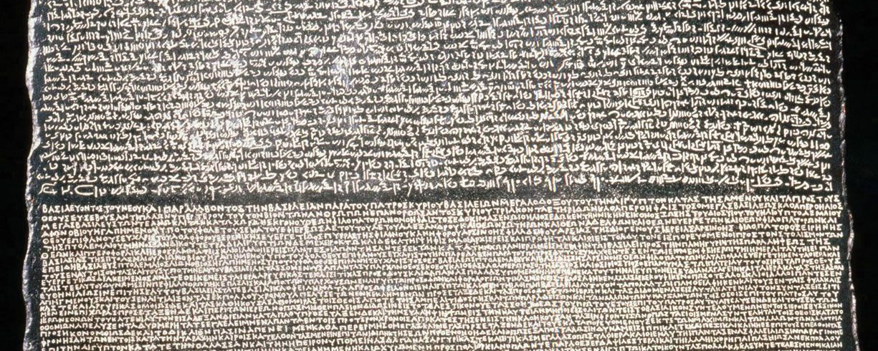
Looking at data

Slide 45
Family relationships
We have seen how English is related to German and, more distantly, to Greek
The family tree we saw before can be extended to show these additional relationships

Slide 46
Family relationships
Indo-European
Celtic
Goidelic
Italic
Irish
Scots Gaelic
Brythonic
Welsh
Latin
Italian
French
Spanish
Germanic
West Germanic
North Germanic
German
Dutch
English
Icelandic
Danish
Swedish
Balto-Slavic
Baltic
Latvian
Lithuanian
Slavic
Polish
Czech
Russian
Indo-Iranian
Indic
Iranian
Hindi
Urdu
Sanskrit
Farsi
Kurdish
Pashto
Breton
Hellenic
Armenian
Albanian
Greek

Slide 47
Family relationships
As this tree shows, most European languages and many Asian languages belong to the Indo-European language family
They descend from a single language, called Proto-Indo-European, which was spoken about 6000 years ago
We have no direct records of Proto-Indo-European, as it was spoken before writing had been invented
However, linguists have been able to reconstruct some of it, by studying the similarities among later languages
Why do you think these languages came to be spoken in places as far apart as Spain and Nepal?
People spread out gradually from one place to another, taking their languages with them

Slide 48
Beyond Indo-European
Of course, there are many other language families besides Indo-European, including:
  Finno-Ugric (Finnish, Hungarian)
  Semitic (Arabic, Hebrew)
  Niger-Congo (Swahili, Zulu)
  Sino-Tibetan (Burmese, Chinese)
  Austronesian (Indonesian, Maori)
  Athabaskan (Apache, Navajo)
There are also languages with no known relatives, such as Basque (spoken in parts of France and Spain)

Slide 49
Beyond Indo-European
One useful resource for studying the languages of the world is the World Atlas of Language Structures (https://wals.info)
On this site you can see interactive maps of where different types of languages are spoken

Slide 50
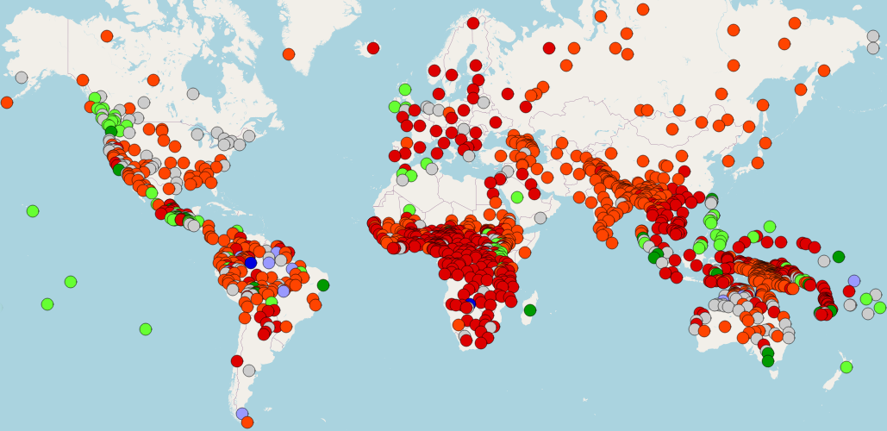
Beyond Indo-European
Cree (N/A)
English (SVO)
Irish (VSO)
Japanese (SOV)
Nadëb (OSV)
Tuvaluan (OVS)
Malagasy (VOS)

Slide 51
Language awareness in schools
How do the topics we’ve seen fit into the school curriculum?

Slide 52
Language awareness in schools
Our project, Language Awareness for Key Stage 3, is based on a cross-curricular approach
The topics covered link English literacy, MFL, and classics
  This can help widen access to subjects that may not be covered by all schools
  Sparking curiosity about languages may help to reverse the well-known decline in MFL uptake

Slide 53
Language awareness in schools
Our activities encourage children speaking different heritage languages to bring their knowledge into the classroom
Language | Genders
Spanish | 2

Slide 54
Language awareness in schools
Our activities encourage children speaking different heritage languages to bring their knowledge into the classroom
Language | Genders
Spanish | 2
Russian | 3

Slide 55
Language awareness in schools
Our activities encourage children speaking different heritage languages to bring their knowledge into the classroom
Language | Genders
Spanish | 2
Russian | 3
Hindi | 2

Slide 56
Language awareness in schools
Our activities encourage children speaking different heritage languages to bring their knowledge into the classroom
Language | Genders
Spanish | 2
Russian | 3
Hindi | 2
Mandarin | 0

Slide 57
Language awareness in schools
Our activities encourage children speaking different heritage languages to bring their knowledge into the classroom
Language | Genders
Spanish | 2
Russian | 3
Hindi | 2
Mandarin | 0
Swahili | 6

Slide 58
Language awareness in schools
Our full suite of resources is available for free download at our website:
https://www.ulster.ac.uk/research/topic/modern-languages-linguistics/quality/research-projects/lawks3/resources

Slide 59
Language awareness in schools
Parallel projects are working to develop language resources for schools elsewhere in the UK

Slide 60
Language awareness in schools
In Wales, the MFL Mentoring project (http://mflmentoring.co.uk) is based at the University of Cardiff
Their resources support the new Curriculum for Wales by integrating MFL with topics such as history and geography

Slide 61
Language awareness in schools
For example, their lesson on surfing includes material on
  The history of
  words used as
  surfing terms
  The history of
  surfing itself
  The geography
  of Peru
  An art project
  about surfboard
  design

Slide 62
Language awareness in schools
In England there are a number of projects working to introduce language awareness into MFL teaching, including
  Linguistics in MFL (for older pupils) (https://www.cantab.net/users/jrkasstan/MFL/index.html)
  World of Languages/Languages of the World (WoLLoW) (for younger pupils)
  (https://theworldoflanguages.co.uk/)

Slide 63
Language awareness in schools
If you’ve enjoyed the questions we’ve been looking at here, your school might be interested in competing in an annual Linguistics Olympiad
  UK Linguistics Olympiad: https://www.uklo.org
  All Ireland Linguistics Olympiad: https://ailo.adaptcentre.ie
Winners of these Olympiads can go on to compete at the international level

Slide 64
Why study languages?
Some of the most commonly cited reasons for learning a new language include
  Cultural understanding
  Broadening horizons
  Becoming an effective global citizen
  Preparing for employment opportunities
  Building an inclusive society
  Fostering literacy
  (British Council NI)

Slide 65



Why study languages?
Language skills are an advantage in a wide variety of careers
One obvious path is teaching a language here, or teaching English abroad
Speech therapists need to understand language to help people who have impediments in speech or grammar
If you work for any organisation with offices or clients in other countries, language skills can be a real asset

Slide 66



Why study languages?
If you’re interested in STEM subjects, there are a number of ways to combine these with languages
If you become a linguist, you can investigate the sorts of phenomena we’ve seen here and the nature of language itself
Developing techniques such as artificial intelligence (AI) and natural language processing (NLP) can help computers to use human language better
Linguistic anthropologists can help document and preserve the world’s many unknown and endangered languages

Slide 67
Why study languages?
Whatever your reason for studying languages, we hope that the techniques shown here and in our other resources will give you skills to make your journey easier

Slide 68
Acknowledgements
We are grateful to the many people who have helped us to develop and deliver these resources:
  The LAwKS-3 steering group
  Our partner school
    St Patrick’s Academy, Dungannon
  Other testing schools
    Merchant Taylors’ School
    Glenalmond College
  MFL Mentoring
  Arts & Humanities Research Council (Grant AH/V005049/1)

Slide 69
Questions
Using the webinar Q&A feature, you can send us any questions that you’d like answered
Thank you for coming to our event!
Dr Christina Sevdali (c.sevdali@ulster.ac.uk)
Dr Morgan Macleod (m.macleod@ulster.ac.uk)

