Slide 1


Language Awareness for Key Stage 3
2: Language Types and Language Families

Slide 2

Roadmap
In this lesson, you will learn about different ways of classifying languages
You will see how languages can be classified
  in terms of the order of words in a sentence
  in terms of how smaller units combine to form larger ones
In some cases, languages are similar because they are related
Related languages are languages that descend from a single, common ancestor
You can view these relationships in the form of a family tree

Slide 3
Language types
In order to understand the similarities and differences between languages, it can be useful to classify them into different types
There are several different ways of classifying languages
One type of classification has to do with how the parts of a sentence are ordered

Slide 4
Language types
​Mary bought a book
(Subject–Verb–Object, English)
​Mariwa hono katta
(Subject–Object–Verb, Japanese)
​Cheannaigh Máire leabhar
(Verb–Subject–Object, Irish)
The other possible orders are also found, in other languages (Verb–Object–Subject, Object–Subject–Verb,
Object–Verb–Subject)
The words with the same colour have the same meaning in each language

Slide 5
Language types
In languages like English, there is usually a single order for subject, verb and object
But there are also languages like German
​Mary brought a book yesterday​ ​
​Maria brachte ein Buch gestern
​Yesterday Mary brought a book
​Gestern brachte Maria ein Buch
In German the verb always has to come second, even when other words move around

Slide 6
Activity
Some of you may know other languages besides the ones mentioned here
What word order is most common in those languages?
Do any of them show the same sort of pattern as German?

Slide 7
Language types
Word order is not the only way to classify languages
All languages can create complex words by combining smaller units
​un- + happy → unhappy
​develop + -ment → development
​chair + -s → chairs
​talk + -ed → talked
Languages can be classified in terms of what they combine and what they leave separate

Slide 8
Language types
Some languages, like Chinese, prefer to express each aspect of the meaning with a separate word
​My dog barked
​Wǒ de gǒu fèi le
Chinese expresses past time by adding a new word rather than adding an ending to an existing word
Where English has a single word for ‘my’, Chinese uses a word meaning ‘of’ (de) and a word meaning ‘me’ (wǒ)

Slide 9
Language types
Other languages prefer to combine as much as possible into a single word
You can see this in a language like Mapudungun (spoken in parts of Chile and Argentina)
​I bought a cow
​Ngillawakan
In this type of language, a single word can correspond to an entire English sentence
On the spectrum between Mapudungun and Chinese, English falls somewhere in the middle
Notice how the parts with the same meaning are in a different order

Slide 10
Language families
One of the most important ways of classifying languages is in terms of their relationships with one another

Slide 11
Language families
Over time, all languages change
When varieties of a language change enough, they can become separate languages, whose speakers are no longer able to understand each other
One of the best-known examples of this process is Latin
Latin gradually developed from a single language into all the modern Romance languages, such as Italian, French, and Spanish
Because Italy, France and Spain are so far apart, people in each place wouldn’t know how people in the other places spoke

Slide 12
Language families
The relationships between these modern languages and Latin can be shown as a simple family tree
Latin
Italian
French
Spanish
In this sort of family tree, Latin is called the mother language
Italian, French and Spanish are the daughter languages of Latin
Italian, French and Spanish are sister languages of each other

Slide 13
Language families
But of course, Latin has a history too
By tracing back the history of Latin and other languages, we can extend our family tree to show more relatives of Latin

Slide 14
Language families
Indo-European
Celtic
Goidelic
Italic
Irish
Scots Gaelic
Brythonic
Welsh
Latin
Italian
French
Spanish
Germanic
West Germanic
North Germanic
German
Dutch
English
Icelandic
Danish
Swedish
Balto-Slavic
Baltic
Latvian
Lithuanian
Slavic
Polish
Czech
Russian
Indo-Iranian
Indic
Iranian
Hindi
Urdu
Sanskrit
Farsi
Kurdish
Pashto
Breton
Hellenic
Armenian
Albanian
Greek
In black are earlier languages that have developed into something different
Other languages have left no direct records
Languages in green are still spoken today
Underlined languages are known directly, from spoken or written sources

Slide 15
Language families
As this tree shows, most European languages and many Asian languages belong to the Indo-European language family
Do you know how languages belonging to the same family came to be spoken in places as far away as Spain and Nepal?

Slide 16
Language families
As this tree shows, most European languages and many Asian languages belong to the Indo-European language family
Do you know how languages belonging to the same family came to be spoken in places as far away as Spain and Nepal?
People spread out gradually from one place to another, just as the ancient Romans travelled from Italy into France and Spain

Slide 17
Language families
All the Indo-European languages descend from a single language, called Proto-Indo-European, which was spoken about 6000 years ago
We have no direct records of Proto-Indo-European, as it was spoken before writing had been invented
However, linguists have been able to reconstruct some of it, by studying the similarities among later languages
In the lessons to come, you’ll see examples of this type of reconstruction

Slide 18
Language families
There are many other language families besides Indo-European, including:
  Finno-Ugric (Finnish, Hungarian)
  Semitic (Arabic, Hebrew)
  Niger-Congo (Swahili, Zulu)
  Sino-Tibetan (Burmese, Chinese)
  Austronesian (Indonesian, Maori)
  Athabaskan (Apache, Navajo)
Other languages have no known relatives, such as Basque (spoken in parts of France and Spain)
All these languages and language families may have further relationships, which are too far back in time for us to recover

Slide 19
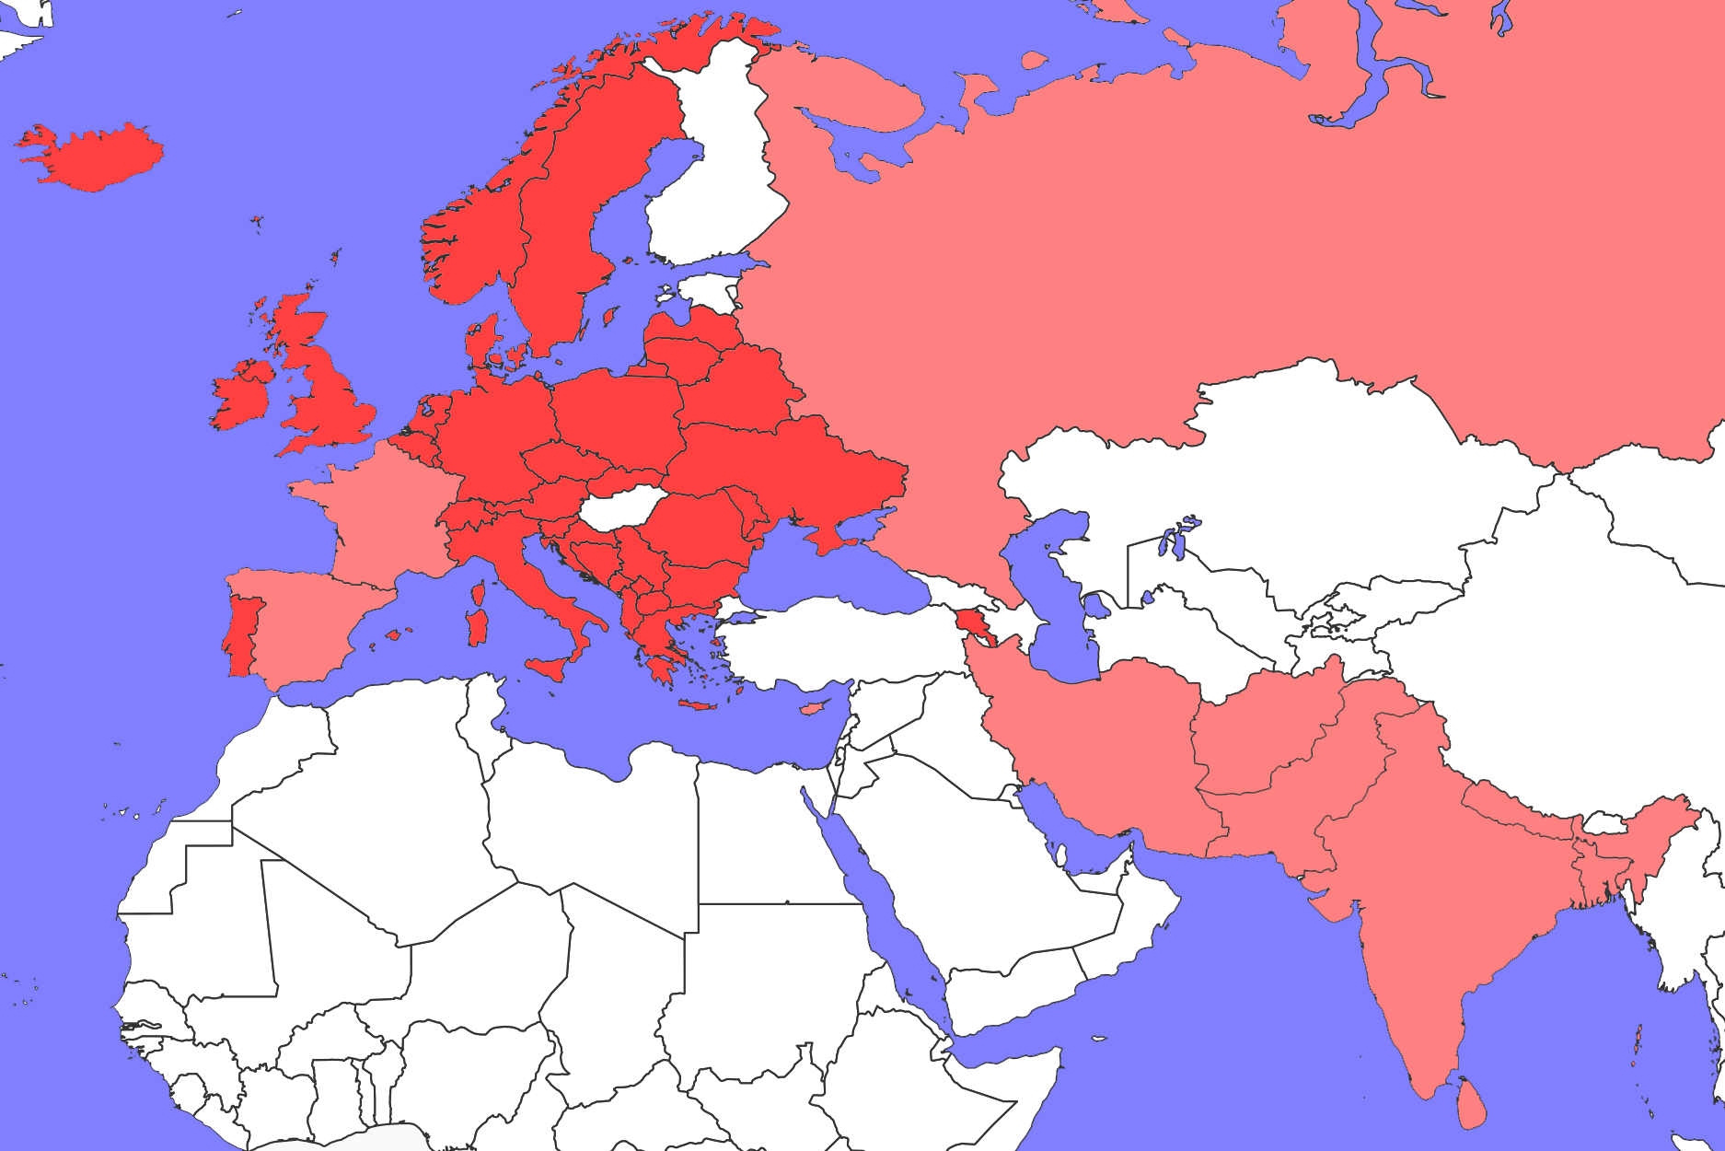
Language families
Indo-European languages
Mixed IE and non-IE
Non-IE languages
This map is based on where languages were originally spoken
It doesn’t show all the different places where languages like English, Russian or Hindi are spoken today
Map from FreeVectorMaps.com

Slide 20
Activity
Take a minute to look at the map of Indo-European languages
Do you notice anything unusual?
If any countries seem different from the surrounding area, see if you can identify them and guess what’s going on

Slide 21
Language families
Indo-European languages
Mixed IE and non-IE
Non-IE languages
Map from FreeVectorMaps.com

Slide 22
Language families
Indo-European languages
Mixed IE and non-IE
Non-IE languages
Map from FreeVectorMaps.com

Slide 23
Conclusion
Languages can be classified in terms of how they form words and how the words are ordered
Over time, languages change and develop into one or more new languages
Languages with the same origin can be grouped into language families
Classifying languages can help us to see the many different types of similarity that languages can share

