Slide 1
Language Awareness for Key Stage 3
3: Writing and Sounds

Slide 2
Roadmap
In this lesson you will learn about the different systems used for writing languages
You will see how writing began with pictures of actual things
These pictures were used in more abstract ways to represent words and sounds
The relationship between letters and sounds can vary over time or between languages
There is a special alphabet that represents all sounds in a constant, uniform way
There are also sign languages that let people communicate without sound

Slide 3
Writing systems
As we saw in the last lesson, the languages that we study have a history that goes back long before writing was invented
Since writing is a relatively recent invention, different peoples have invented a number of different writing systems
These writing systems focus on different aspects of language to represent speech in different ways

Slide 4
Activity
Some of you may know languages that use a different alphabet from English
How many of these languages can you identify?
For each of these other alphabets, how many languages do you know that use the same alphabet?

Slide 5
Writing and pictures
The symbols that make up a writing system are called characters
These characters often derive from pictures of actual things
Many Chinese characters are still based on such pictures
人 rén ‘person’

Slide 6
Writing and pictures
However, pictures can only convey a certain amount of information
Writing systems like Chinese combine symbols that represent concepts with symbols that represent sounds
This symbol gives you a clue to the meaning
This symbol shows you how the word is pronounced
女 | + | 馬 | = | 媽
nǚ ‘female’ |  | mǎ ‘horse’ |  | mā ‘mother’

Slide 7
Writing and pictures
A writing system originally based on pictures can evolve into a true alphabet, where each symbol stands for a sound
A
🐮

Slide 8
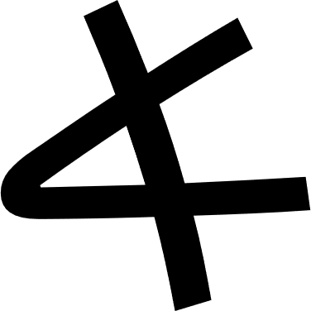
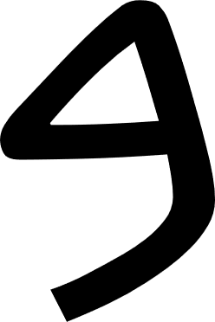
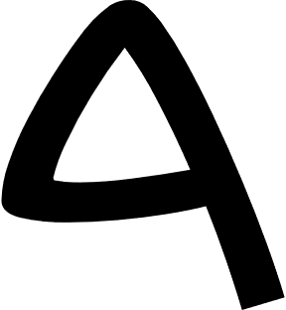
Alphabets
Most alphabets now in use descend from an alphabet developed by the ancestors of the ancient Phoenicians, over 3000 years ago
The shapes of the letters have evolved in different ways
Phoenician
Hebrew | א | ב | ג | ד | ה
Arabic | ا | ب | ج | د | ه
Greek | Α | Β | Γ | Δ | Ε

Slide 9
Alphabets
The Greek alphabet was adapted by the Romans to form the alphabet that we use
Other alphabets have been adapted in turn from these
Greek | Α | Β | Γ | Δ | Ε
Roman | A | B | C | D | E
Cyrillic (Russia) | А | В | Г | Д | Е
Runic (Anglo- Saxons/Vikings) | ᚫ | ᛒ | ᚳ | ᛞ | ᛖ

Slide 10
Syllabic writing
In the alphabet that we use, each letter stands for a single sound
There are some writing systems where each letter stands for a whole syllable

Slide 11
Syllabic writing
One type of syllabic writing is Japanese hiragana script
As you can see, to change the vowel you need to use a completely different character
き | く
ki | ku

Slide 12
Syllabic writing
Do you think that syllabic scripts would work equally well for all languages?
If not, which types of languages would they suit best?

Slide 13
Syllabic writing
Syllabic scripts work best for languages like Japanese, where most syllables have exactly one consonant and one vowel
If a language has a greater number of syllable types, this would make it very complicated to have a separate character for each syllable
Syllabic scripts have been adapted in various ways so that they can be used for more syllable types without becoming too complex

Slide 14
Syllabic writing
The Devanagari scripts that are used for many languages of India were originally syllabic
However, they now have ways of representing consonants and vowels separately
क | = | क् | + | अ
ka |  | k |  | a

Slide 15
Accents
Adding accent marks is an easy way to extend the range of sounds represented without needing a completely new alphabet
Accents are often added to the Roman alphabet as well
For example, where English has a single letter <e>, French adds accents to create three different characters <e>, <è>, and <é>
This means that French can distinguish more clearly between three separate sounds

Slide 16
Activity
Do you know any accent marks other than the acute <´> and grave <`> that we have just seen?
What letters do they modify?
Which languages use these accents?

Slide 17
Writing and sounds
Even when accents are used, an alphabet is not always a perfect representation of the sounds that people speak
For example, letters can have different sounds in different languages
The sound represented by <r> in English is fairly unusual
In many languages, the <r> sound is more like Spanish, a flap or trill with the front of the tongue
There are also languages like French and German, where the <r> sound is made in the back of the throat

Slide 18
Writing and sounds
The meaning of letters can also change over time so that they come to represent different sounds
in the Phoenician alphabet represented a consonant, [h]
The Greeks used the symbol <Ε> for a vowel
In Greek (as in Phoenician) <Γ> was pronounced [g]
The Roman form, <C>, had a different sound [k]

Slide 19
Writing and sounds
Linguists have developed a special alphabet, the International Phonetic Alphabet (IPA)
In this alphabet, there is a unique symbol for every sound in all the world’s languages
This can be used to show how different sounds can correspond to the same spelling
 | English | French
<action> | [ˈækʃṇ] | [akˈsjɔ̃]
<parking> | [ˈpɑkɪŋ] | [pɑᴚˈkiŋ]

Slide 20
Writing and sounds
In these lessons, we’ll be using the familiar Roman alphabet as much as possible
If you look up words in a dictionary, though, you might see pronunciations given in the International Phonetic Alphabet

Slide 21
Sign languages
So far, we’ve been talking about writing as a system for recording sounds
But there are some languages that aren’t based on sound at all
Deaf people use sign languages to communicate without sound

Slide 22
Sign languages
No one knows exactly where sign language first came from (like spoken language)
Sign language is more than just instinctive pantomime
It seems to have evolved gradually over time

Slide 23
Sign languages
Different sign languages are spoken in different parts of the world
Like spoken languages, sign languages can be grouped into families

Slide 24
Sign languages

Slide 25
Sign languages
Sign languages combine different shapes and gestures into complex patterns, just as spoken languages do with sound
They also have their own grammar, which puts these simple signs together to express complex abstract concepts

Slide 26
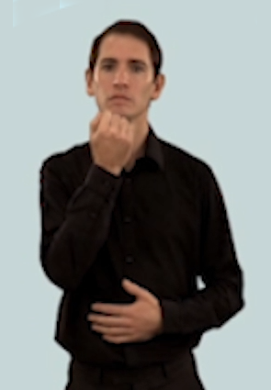
Sign languages
For example, this gesture in British Sign Language means ‘number’

Slide 27
Sign languages
By using the same hand shape, but moving it in a different way, you can make it mean ‘greedy’

Slide 28
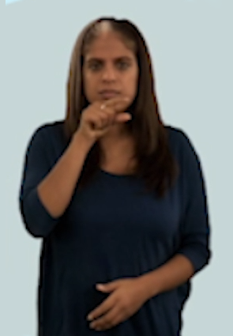
Sign languages
By using a different hand shape in the same place, you can say ‘bird’

Slide 29
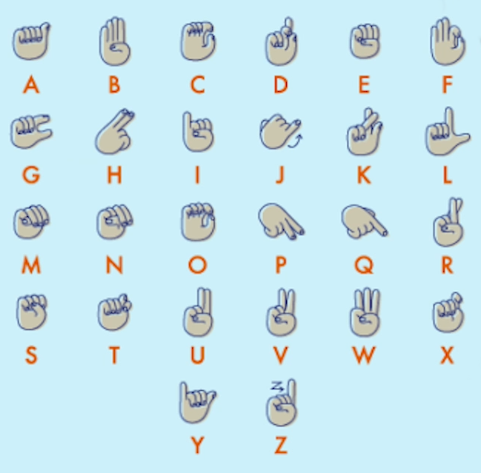
Sign languages
Sign languages also have an alphabet for individual letters
This is used for ‘fingerspelling’, spelling out names and places that there is no sign for

Slide 30
Conclusion
Writing systems grow and evolve in the same way as languages, but independently of the languages that they write
Some writing systems use one symbol for a whole word
Other writing systems use one symbol for each syllable
Alphabets, such as the one that we use, have one symbol for each sound
However, the sounds corresponding to each letter can vary between languages and over time
The International Phonetic Alphabet provides a uniform way of representing all sounds
Sign language provides a way of communicating without sound

