Slide 1


Language Awareness for Key Stage 3
15: Word Order

Slide 2

Roadmap
Today we will look at word order and how languages arrange words in different ways
We will see different orders that languages use for subjects, objects and verbs
We will look at different word orders for adjectives and adpositions (prepositions/postpositions, e.g. on)
We will also look at how word order can vary within a single language and how languages use different word orders
We will see how word order patterns can tell us about the structure of language in general

Slide 3
Word Order
You may remember from our first lesson that different languages have different orders for subject, object and verb
​Subject–Verb–Object (SVO): I saw them
​Subject–Object–Verb (SOV): I them saw
​Verb–Subject–Object (VSO): Saw I them
​Verb–Object–Subject (VOS): Saw them I
​Object–Verb–Subject (OVS): Them saw I
​Object–Subject–Verb (OSV): Them I saw

Slide 4
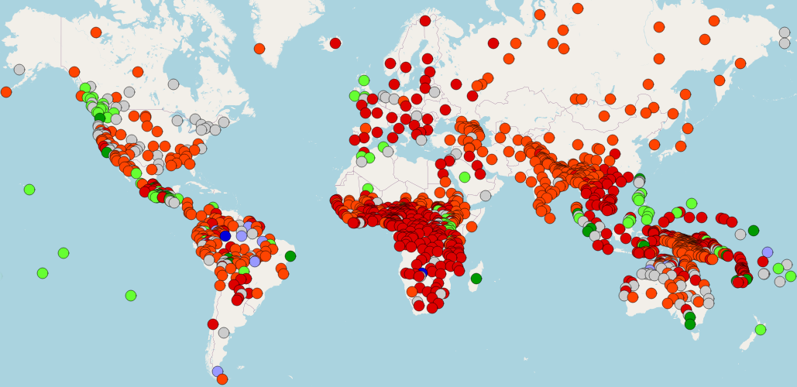
Word Order
Cree (N/A)
English (SVO)
Irish (VSO)
Japanese (SOV)
Nadëb (OSV)
Tuvaluan (OVS)
Malagasy (VOS)
Map adapted from WALS

Slide 5
Word Order
From the map you can see that some types of languages are much more common than others

Slide 6
Word Order
Most languages show a preference for having the subject before the verb, and having the subject before the object
Why do you think this might be?

Slide 7
Word Order
Most languages show a preference for having the subject before the verb, and having the subject before the object
Why do you think this might be?
The evidence suggests that these types of language are somehow ‘easier’
However, we don’t yet have enough data to say what makes this easier, or in what way

Slide 8
Word Order
The order of subjects, objects and verbs is not the only thing that can vary from language to language
You may remember that languages have different types of adpositions
  Some languages have prepositions, which come before the noun
  Others have postpositions, which come after the noun
​in Japan 9. Nihon ni
​from Tokyo 10. Tokyo kara
(English) (Japanese)

Slide 9
Word Order
Likewise, adjectives in some languages come before the noun, while in others they follow it
​black coffee (English)
​schwarzer Kaffee (German)
​kuroi kōhī (Japanese)
café noir (French)
caife dubh (Irish)
coffi du (Welsh)

Slide 10
Word Order
There are patterns in this variation in word order
For example, languages with the verb before the object tend to have prepositions before the noun
Languages with the object before the verb are more likely to have nouns followed by postpositions

Slide 11
Word Order
However, there are exceptions to some of these patterns
For example, languages with the verb before the object often place nouns before adjectives, as in Irish
However, in English the verb comes before the object, but adjectives come before the noun

Slide 12
Word Order
Why do these patterns exist at all?
They can be seen as different applications of the same general principles
For example, verbs have the same sort of role in regard to their objects as prepositions do
​Verbs and prepositions specify the type of relationship that exists, and the objects specify what the relationship is to
A hedge surrounds the garden
There is a hedge around the garden

Slide 13
Word Order
We can say that in relation to their objects, verbs and prepositions are both heads
The verb and the object that depends on it form a single unit, the verb phrase, with the verb as the head of the phrase
The same is true for prepositions and prepositional phrases
The patterns that we see in word order can then be expressed as a single statement
In any given language, heads will tend to have the same order with respect to their dependants

Slide 14
Word Order
Head + Dependant
  ​Verb + Object, Preposition + Noun…
Dependant + Head
  ​Object + Verb, Noun + Postposition…

Slide 15
Activity
Some of you may know languages other than the ones we’ve discussed here
Take some time to make a note of word orders in these languages
  You can look at subjects/objects/verbs, nouns/adjectives, and nouns/adpositions
If a language can have more than one order, try to choose the most basic, “ordinary” one
Afterwards, you can compare notes. What patterns do you see?

Slide 16
Word Order
So far, when we have talked about word order we have only been looking at a single, “basic” word order for each language
However, many languages allow you to vary this basic word order for different reasons

Slide 17
Word Order
You may remember that languages in which subjects and objects are clearly marked using case endings can be very flexible about word order
For example, in Latin there are six different ways of saying ‘John saw Mary’
​Johannes Mariam vidit 22. Vidit Mariam Johannes
​Johannes vidit Mariam 23. Mariam vidit Johannes
​Vidit Johannes Mariam 24. Mariam Johannes vidit

Slide 18
Word Order
What good are all these different orders?
One use for them is to change the emphasis
In Latin, the normal order is subject–object–verb
​Johannes Mariam vidit
‘John saw Mary’
By rearranging the sentence, you can focus on different words
​Mariam Johannes vidit
‘As for Mary, John saw her’, ‘It was Mary that John saw’, etc.
As you can see, changing the emphasis in English often results in a more complex structure

Slide 19
Word Order
Even in English, you can sometimes add emphasis just by changing the order of words
​Mary’s alright, but John I hate
However, examples like this are unusual enough that we can still say the usual order for English is SVO

Slide 20
Word Order
One very common use for different word orders is to distinguish different types of speech act
​Mary is so happy. (statement)
How happy is Mary? (question)
How happy Mary is! (exclamation)

Slide 21
Questions
Moving the verb before the subject is a very common way of forming questions in Indo-European languages
​Is Mary happy? (English)
​Ist Maria froh? (German)
¿Está Maria feliz? (Spanish)
However, there are also other ways of forming questions

Slide 22
Questions
Another way to form questions is by leaving the words in the same order and just using a different tone of voice
​Mary’s happy?
In English, this sort of question is often used to echo a previous statement
Mary’s happy.
She’s happy?

Slide 23
Activity
Take some time and try to think of other situations where you might use this sort of question in English
Can you come up with a list of rules about when to use which sort of question?

Slide 24
Questions
Some languages make much more extensive use of questions that leave the words in the same order
This is the most common sort of question in informal French
​Est-elle heureuse? (formal)
‘Is she happy?’
​Elle est heureuse? (informal)
‘She’s happy?’

Slide 25
Questions
In other languages, this is the only way of asking questions
In Amharic (spoken in Ethiopia), all questions have the same word order as statements
​Mariyami desitenya nati
‘Mary is happy’
​Mariyami desitenya nati?
‘Is Mary happy?’

Slide 26
Sentence Structure
So far we have only been looking at the order of words
But word order is inseparable from other aspects of language
For example, word order can have an effect on agreement
You may remember from the last lesson that verbs agree with their subjects
However, agreement can be affected by word order

Slide 27
Sentence Structure
In Arabic, subjects can appear before or after the verb
​L-tullaabu wasaluu
‘The students have arrived’
​Wasala l-tullaabu
‘The students have arrived’
(literally, ‘Has arrived the students’)
When the verb comes first, it no longer agrees with the subject
The verb is singular, but the subject is plural

Slide 28
Sentence Structure
However, this does not happen in most languages that allow multiple word orders
​Hoi mathētaì aphíkonto (Greek)
‘The students have arrived’
​Aphíkonto hoi mathētaí
literally, ‘Have arrived the students’
As you saw earlier, word order has no effect on agreement in Latin either

Slide 29
Sentence Structure
What do these differences mean?
Even though we see the same word orders in Arabic and Greek, the similarities are just on the surface
There’s a sense in which the verb in Arabic is actually in a “different” place from Greek, even if all you can see on the surface is that they are both before their subjects
It almost seems that in Arabic the verb is somewhere where the subject can’t “reach” it

Slide 30
Sentence Structure
Studying these sorts of similarities and differences between languages can let us see patterns that exist “below the surface” of language
When we look at these things, we are studying syntax
Syntax is the system of rules that a language has for combining words into sentences
In the next lessons we will see more examples of these patterns

Slide 31
Conclusion
Today we have seen how different languages have different rules for arranging the words in a sentence
We have seen how specific differences that seem arbitrary can be expressed in terms of more general rules
We have looked at the use of special word orders for special purposes such as questions
We have seen that in some languages word order can affect agreement
This is an example of how languages can seem the same on the surface but be different underneath

