Slide 1


Language Awareness for Key Stage 3
18: Language Variation

Slide 2

Roadmap
Today we will look at language variation
We will see how new languages emerge when a language changes differently in different places
We will see how similar variation can exist even within a single language
Different varieties of a language can be grouped into different dialects

Slide 3
Language variation
You may remember that in a previous lesson, we looked at how languages can change over time
This sort of change produces language families

Slide 4
Language variation
We saw that as the ancient Romans spread out from Italy into France and Spain, they took their language with them
Over time, the language slowly changed in each of these places
Because they were so far apart, the language changed in different ways in each place

Slide 5
Language variation
For example, people in different areas sometimes used different words for the same things
 | Spain | France | Italy
house | casa | mansio | casa
leg | perna | gamba | gamba
work | trepalium | trepalium | labor

Slide 6
Language variation
Even when the same word was used, it might be pronounced differently in different places
These changes made the modern languages even more different from each other
 | Spanish | French | Italian
house | casa | maison | casa
leg | pierna | jambe | gamba
work | trabajo | travail | lavoro

Slide 7
Language variation
Latin
Italian
French
Spanish
Portuguese
Romanian
…
The result was the Romance language family

Slide 8
Language variation
English is part of a language family too, the Germanic family

Slide 9
Language variation
Proto-Germanic
West Germanic
North Germanic
East Germanic
Gothic
English
Frisian
Dutch
German
Icelandic
Norwegian
Danish
Swedish

Slide 10
Language variation
As we saw before, the Germanic and Romance families are related, and belong to the larger Indo-European language family

Slide 11
Language variation
Indo-European
Celtic
Goidelic
Italic
Irish
Scots Gaelic
Brythonic
Welsh
Latin
Italian
French
Spanish
Germanic
West Germanic
North Germanic
German
Dutch
English
Icelandic
Danish
Swedish
Balto-Slavic
Baltic
Latvian
Lithuanian
Slavic
Polish
Czech
Russian
Indo-Iranian
Indic
Iranian
Hindi
Urdu
Sanskrit
Farsi
Kurdish
Pashto
Breton
Hellenic
Armenian
Albanian
Greek

Slide 12
Variation in English
Many of the changes that we’ve been looking at happened long ago
For example, people have been speaking differently in Italy and France for nearly 2,000 years
But of course, change and variation in language didn’t stop then

Slide 13
Variation in English
Like the ancient Romans, people speaking English have spread out to many different parts of the world, taking their language with them
As a result, English has taken on different forms in different countries

Slide 14
Variation in English
English
British English
American English
Canadian English
Australian English
Indian English
…
Jamaican English
Irish English

Slide 15
Variation in English
Even when we use terms like ‘British English’ or ‘American English’, this doesn’t mean that they refer to something homogeneous
For example, people speak differently in London and Newcastle, or in New York and Texas

Slide 16
Variation in English
Even within Northern Ireland, there are many different ways of speaking

Slide 17
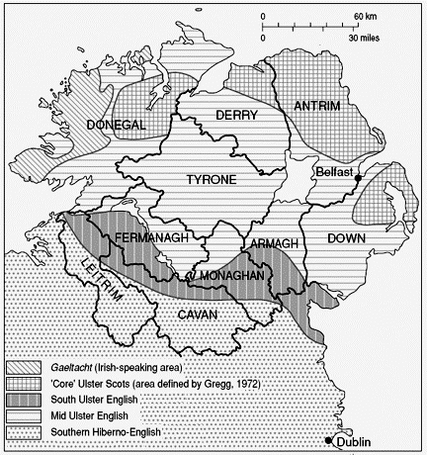
Language variation
(from Harris 1984)

Slide 18
Activity
Take some time to think about different varieties of English
What sorts of differences can you find?
  Differences in pronunciation (accent)?
  Differences in the words they use?
  Differences in grammar?

Slide 19
Languages and dialects
Even though English has developed differently in different places, it hasn’t split into different languages, like Latin did
People from opposite sides of the globe who speak ‘English’ can still understand each other — more or less
However, people who speak Italian can only understand French if they study it at school or elsewhere, and vice versa
Sometimes people make a distinction between the two degrees of difference
The distinction is that French and Italian are different languages, but the various types of English are different dialects

Slide 20
Languages and dialects
The difference between a language and a dialect can be hard to pin down
Some ‘dialects’ of English might be different enough that people actually do have trouble understanding each other
Some ‘languages’, such as Norwegian and Swedish, are actually similar enough that people can understand each other without needing to be taught

Slide 21
Languages and dialects
In some cases, it can be hard to draw a firm line between languages
For example, there’s a clear border between Germany and the Netherlands, but not such a clear border between German and Dutch

Slide 22
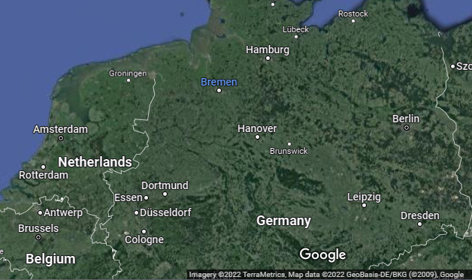
Languages and dialects
If you started at Amsterdam and went east to Berlin, the language you heard would change very gradually

Slide 23
Languages and dialects
However, this doesn’t mean that Dutch and German are really two dialects of a single language
‘Standard Dutch’ and ‘Standard German’, the languages you might see in books and newspapers from Amsterdam and Berlin, are quite different from each other
The ‘Dutch’ and ‘German’ that people speak at home with family and friends might not be quite like this.
But if people think of their language as ‘Dutch’, then sometimes they might sound more like someone from Amsterdam, but they wouldn’t start talking like someone from Berlin
  And vice versa, if they think of their language as ‘German’

Slide 24
Languages and dialects
The distinction between ‘languages’ and ‘dialects’ might not be black and white
  In the next lesson we’ll see more about how people speak differently in different situations
However, the question of whether two people speak the same language is usually easy to answer in practice
If you met someone from Australia and someone from France, it wouldn’t be hard to decide whether you all spoke one language, or two, or three

Slide 25
Activity
Some of you may know languages other than the ones we’ve been looking at
Do these languages have any different varieties?
What are some of the differences between them?
What are the names for these varieties?

Slide 26
Conclusion
Today we’ve looked at language variation
We’ve seen how variation within a language can lead to the emergence of new languages
We’ve seen how a single language can have more than one dialect
It is not always easy to draw a line between dialect differences and language differences

